Slide 1
Software Quality Assurance
/
Software Quality Engineering
Lecture 4
Naseer Ahmed

Slide 2
The 6 STLC Phases In-Depth
Phase 1: Requirement Analysis
During this phase, feature requirements collected in the SDLC process are evaluated to identify testable aspects. If necessary, testing teams may need to consult with stakeholders to clarify requirements. These requirements can either be functional or non-functional, defining what a feature can do or it’s characteristics respectively. The ability to automate testing is also evaluated during this phase.
Entry Criteria—documented requirements, acceptance criteria, and intended product architecture.
Exit Criteria—approved requirement traceability matrix (RTM) and automation feasibility report.

Slide 3
The 6 STLC Phases In-Depth
Phase 2: Test Planning
During this phase, the test strategy is outlined in a test plan document. This strategy includes tools needed, testing steps, and roles and responsibilities. Part of determining this strategy is a risk and cost analysis and an estimated timeline for testing.
Entry Criteria—requirement analysis, RTM, and automation feasibility report.
Exit Criteria—approved test plan including timelines and risk/cost analysis.

Slide 4
The 6 STLC Phases In-Depth
Phase 3: Test Case Development
During this phase, test cases are created. Each case defines test inputs, procedures, execution conditions, and anticipated results. Test cases should be transparent, efficient, and adaptable. Once all test cases are created, test coverage should be 100%. Any necessary automation scripts are also created during this phase.
Entry Criteria—approved test plan including timelines and risk/cost analysis.
Exit Criteria—approved test cases and automation scripts.

Slide 5
The 6 STLC Phases In-Depth
Phase 4: Test Environment Setup
During this phase, testing environments are configured and deployed. This phase may include a variety of testing tools, including Test Complete, Selenium, Appium, or Katalon Studio. Sometimes, this phase also includes setting up test servers. Once environments are deployed, smoke tests are performed to ensure that environments are working as expected with all intended functionality.
Entry Criteria: system design and project architecture definitions.
Exit Criteria: a fully functional test environment and approved test cases.

Slide 6
The 6 STLC Phases In-Depth
Phase 5: Test Execution
During this phase, features are tested in the deployed environment, using the established test cases. Expected test results are compared to actual and results are gathered to report back to development teams.
Entry Criteria—all exit criteria from previous steps.
Exit Criteria—all tests are performed and results are documented.

Slide 7
The 6 STLC Phases In-Depth
Phase 6: Test Cycle Closure
This is the last phase of the STLC, during which a test result report is prepared. This report should summarize the entire testing process and provide comparisons between expected results and actual. These comparisons include objectives met, time taken, total costs, test coverage, and any defects found.
Entry Criteria—test results and logging from all previous phases.
Exit Criteria—delivered and approved test closure report.

Slide 8
The 6 STLC Phases In-Depth
What is Entry and Exit Criteria in STLC?
Entry Criteria: Entry Criteria gives the prerequisite items that must be completed before testing can begin.
Exit Criteria: Exit Criteria defines the items that must be completed before testing can be concluded

Slide 9
SOFTWARE QUALITY
What is software quality?” evokes many different answers. Quality
is a complex concept—it means different things to different people, and it is highly context dependent. How software quality is perceived in different ways in different domains, such as philosophy, economics, marketing, and management.
There are five views of quality in a comprehensive manner as follows:
Transcendental View: It envisages quality as something that can be recognized but is difficult to define. The transcendental view is not specific to software quality alone but has been applied in other complex areas of everyday life.

Slide 10
SOFTWARE QUALITY
User View: It perceives quality as fitness for purpose. According to this view, while evaluating the quality of a product, one must ask the key question: “Does the product satisfy user needs and expectations?”
Manufacturing View: Here quality is understood as conformance to the specification. The quality level of a product is determined by the extent to which the product meets its specifications.
Product View: In this case, quality is viewed as tied to the inherent characteristics of the product. A product’s inherent characteristics, that is, internal qualities, determine its external qualities.
Value-Based View: Quality, in this perspective, depends on the amount a customer is willing to pay for it.

Slide 11
SOFTWARE QUALITY
Various software quality models have been proposed to define quality and its related attributes.
The most influential ones are the ISO 9126 [20–22] and the CMM [14]. The ISO 9126 quality model was developed by an expert group under the aegis of the International Organization for Standardization (ISO).
The document ISO 9126 defines six broad, independent categories of quality characteristics:
Functionality
Reliability
Usability
Efficiency
Maintainability
portability

Slide 12
SOFTWARE QUALITY
The CMM was developed by the Software Engineering Institute (SEI) at Carnegie Mellon University. In the CMM framework, a development process is evaluated on a scale of 1–5, commonly known as level 1 through level 5. For example, level 1 is called the initial level, whereas level 5—optimized—is the highest level of
process maturity
In the field of software testing, there are two well-known process models, namely, the test process improvement (TPI) model [23] and the test maturity Model (TMM) [24]. These two models allow an organization to assess the current state. of their software testing processes, identify the next logical area for improvement, and recommend an action plan for test process improvement.

Slide 13
SOFTWARE QUALITY
The CMM was developed by the Software Engineering Institute (SEI) at Carnegie Mellon University. In the CMM framework, a development process is evaluated on a scale of 1–5, commonly known as level 1 through level 5. For example, level 1 is called the initial level, whereas level 5—optimized—is the highest level of
process maturity
In the field of software testing, there are two well-known process models, namely, the test process improvement (TPI) model [23] and the test maturity Model (TMM) [24]. These two models allow an organization to assess the current state. of their software testing processes, identify the next logical area for improvement, and recommend an action plan for test process improvement.

Slide 14
ROLE OF TESTING
software testing is a verification process for software quality assessment and improvement. Generally speaking, the activities for software quality assessment can be divided into two broad categories.
Static analysis
Dynamic analysis

Slide 15
ROLE OF TESTING
Static Analysis:
As the term “static” suggests, it is based on the examination of a number of documents, namely requirements documents, software
models, design documents, and source code. Traditional static analysis includes code review, inspection, walk-through, algorithm analysis, and proof of correctness. It does not involve actual execution of the code under development. Instead, it examines code and reasons over all possible behaviors that might arise during run time. Compiler optimizations are standard static analysis

Slide 16
ROLE OF TESTING
Dynamic Analysis:
Dynamic analysis of a software system involves actual program execution in order to expose possible program failures. The behavioral and performance properties of the program are also observed. Programs are executed with both typical and carefully chosen input values. Often, the input set of a program can be impractically large. However, for practical considerations, a finite subset of the input set can be selected. Therefore, in testing, we observe some representative program behaviors and reach a conclusion about the quality of the system. Careful selection of a finite test set is crucial to reaching a reliable conclusion

Slide 17
VERIFICATION AND VALIDATION
Verification and Validation is the process of investigating that a software system satisfies specifications and standards and it fulfills the required purpose.
Verification: Are we building the product right?
Validation: Are we building the right product?

Slide 18
VERIFICATION AND VALIDATION
Verification:
The verifying process includes checking documents, design, code, and program
It does not involve executing the code
Verification uses methods like reviews, walkthroughs, inspections, and desk- checking etc. Whether the software conforms to specification is checked
It finds bugs early in the development cycle
Target is application and software architecture, specification, complete design, high level, and database design etc.
QA team does verification and make sure that the software is as per the requirement in the SRS document.
It comes before validation

Slide 19
VERIFICATION AND VALIDATION
Validation:
It is a dynamic mechanism of testing and validating the actual product
It always involves executing the code
It uses methods like Black Box Testing, White Box Testing, and non-functional testing
It checks whether the software meets the requirements and expectations of a customer
It can find bugs that the verification process can not catch
Target is an actual product
With the involvement of testing team validation is executed on software code.
It comes after verification

Slide 20

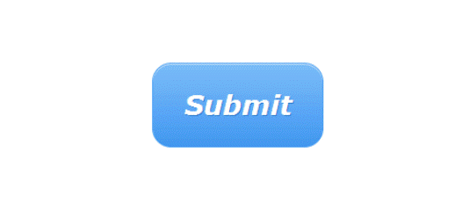
VERIFICATION AND VALIDATION
Example of verification and validation:
In Software Engineering, consider the following specification for verification testing and validation testing, A clickable button with name Submet
Verification would check the design doc and correcting the spelling mistake.
Otherwise, the development team will create a button like
So new specification is
A clickable button with name Submit
Once the code is ready, Validation is done. A Validation test found

Slide 21
VERIFICATION AND VALIDATION
Example of verification and validation:
Owing to Validation testing, the development team will make the submit button clickable
Button Not Clickable

Slide 22
VERIFICATION AND VALIDATION
Activities involved in verification:
Inspections
Reviews
Walkthroughs
Desk-checking
Activities involved in validation:
Black box testing
White box testing
Unit testing
Integration testing

Slide 23
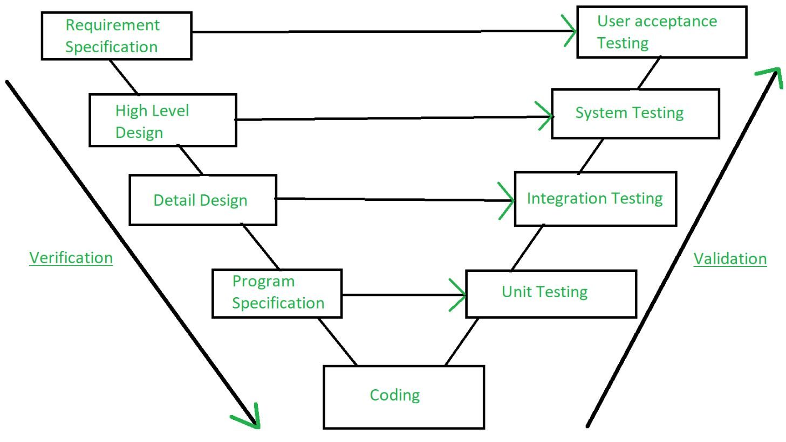
VERIFICATION AND VALIDATION

